Slide 1
Game Design and Programming
Neil Gannon 2017

Slide 2
This Week
Project Details
Quick Week 1 Code Revision
Code for this Week
Progress Checkpoints
Kill Volume
Hide Sprite
Extending Player Movement
Player Sprite Controller

Slide 3
Project

Slide 4
Schedule
8 Weeks from now until Easter Break
Easter break 26th March
4 weeks after Easter break
3 weeks for project
1 week for presenting projects

Slide 5
Schedule
Week | Work
1 | Idea and Proposal
2 | Story Progression and Gameplay Mechanics
3 | Team Roles and Tasks (Start Development)
4 | Development
5 | Development
6 | Development
7 | Development
8 | In Class Evaluation of Work Completed

Slide 6
Groups
Going to allow teams of 4 to be formed by students
Some groups may be bigger or smaller by one person
Depends on the class size
Teams must be formed by the end of your lab class this week
Each team must
Nominate one person to be team leader
Pick a team name
Write a single page pitch of your game
Pick a game name
Submit proposal document on Moodle by next class

Slide 7
Theme
Exploration

Slide 8
Week 1 Revision

Slide 9
Methods
Access
Private means we can access the variable inside the script but not outside of it
Public means we can access the variable both inside and outside the script
Instance
To call a method on a script
We need access to the instance of the script
Get the object -> GetComponent<YourScript>() -> access to the methods and variables
Remove creation of local variables from the Update
If we are creating variables in the Update method then we should consider moving these to be instance variables

Slide 10
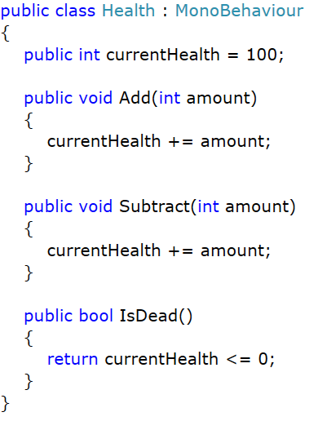
Health
A general purpose health script
Tracks the current health
Allows for an amount to added to the health
Allows for an amount to subtracted from the health
Allows us to check is the health is 0 or beneath
Can be attached to any object
No reliance on any other script

Slide 11
Checkpoints

Slide 12
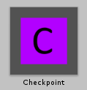
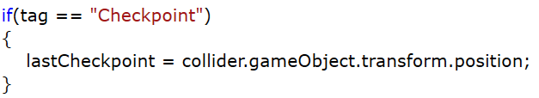
Checkpoint
A checkpoint is a mechanism to save the progress a player has made in a scene
Positional progress
A checkpoint requires
Tag of Checkpoint
BoxCollider2D set as a trigger
Sprite (needs to be hidden when playing)
If the player hits a trigger tagged as checkpoint
Save the position of the checkpoint in a variable for use later

Slide 13
Kill Volume

Slide 14
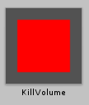
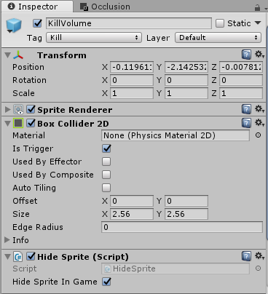
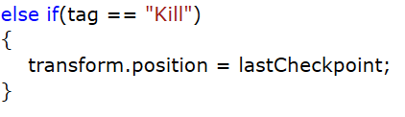
Kill Volume
An invisible volume which will kill the player or other objects if they hit it
Requires
A BoxCollider2D that is set to be a trigger
Sprite so we can see position/size in the level
HideSprite script to hide the sprite when the game is running
Use
Using OnTriggerEnter2D detect if an object tagged as Kill has been hit

Slide 15
Hide Sprite

Slide 16
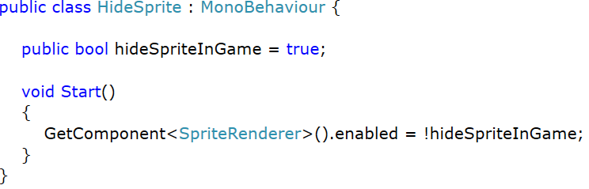
Hide Sprite
We want to easily place invisible objects in the game
Still need to see them when designing the scene
We need to disable the sprite on an object when the game is being played
The HideSprite script will disable the sprite renderer of an object when the game starts

Slide 17
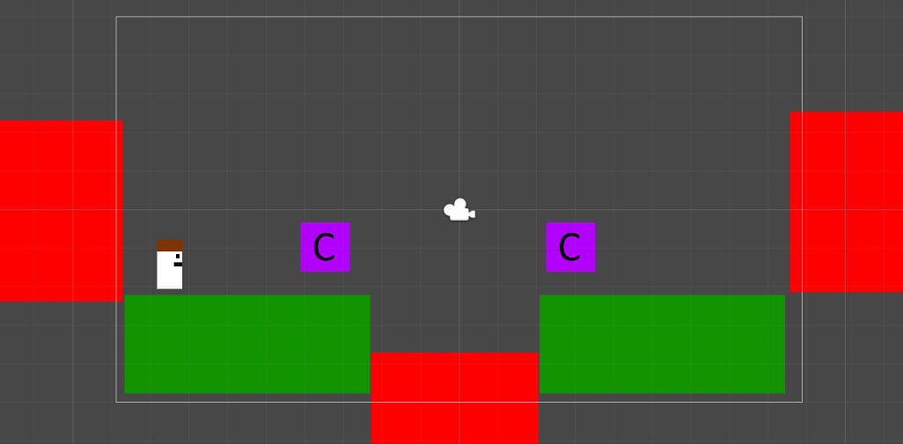

Slide 18


Slide 19
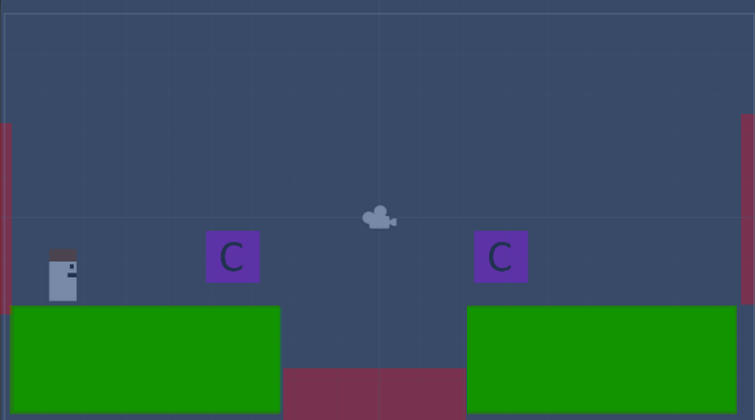

Slide 20
Extending Player Movement

Slide 21
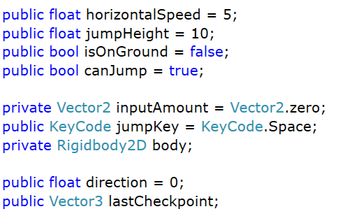
Variables
Store the results of the Input.GetAxis in a Vector2
Store the Jump Key as variable that can be set in the editor
Store the direction (left/right) the player is moving in
Save the last checkpoint position
Store the RigidBody2D for use later

Slide 22
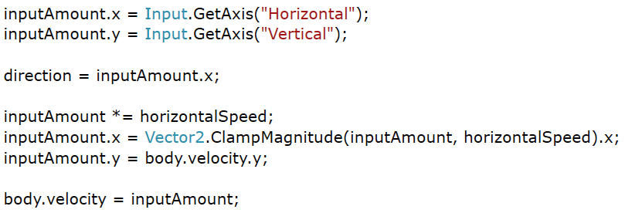
Input.GetAxis
A Vector2 has two components
X Value
Y Value
Store the Horizontal and Vertical values from Input.GetAxis in the X and Y component of inputAmount
Direction is determined by the X value of inputAmount
Set the velocity to be inputAmount

Slide 23
Clamping Horizontal Velocity
We want to stop the player from going too fast horizontally
Vector2.ClampMagnitude allows us to keep a Vector2 within a bounds
Max or Min value that the vector must stay within
Vector2.ClampMagnitude returns a new Vector2
Currently we just access the returned X value

Slide 24
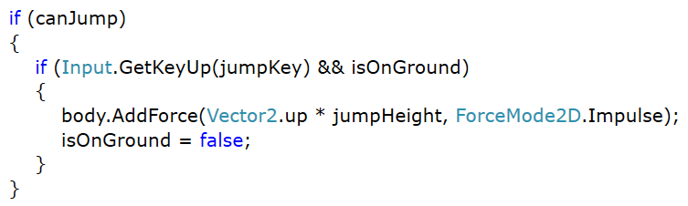
Basic Jumping
Based on code from last semester
If the player is allowed to jump
If the player has pressed the jump key and the player is on the ground
Add force to the rigid body
Update isOnGround

Slide 25
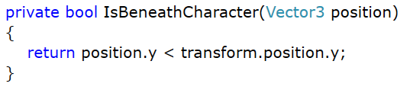
IsBeneathCharacter
We want to be able to determine if the ground is beneath the player
A simple check for this is base don the position of each object
If the ground is lower than the player
Then it is considered to be beneath it
This will not work in all cases
We will cover a more complex solution in the future

Slide 26
Player Sprite Controller

Slide 27
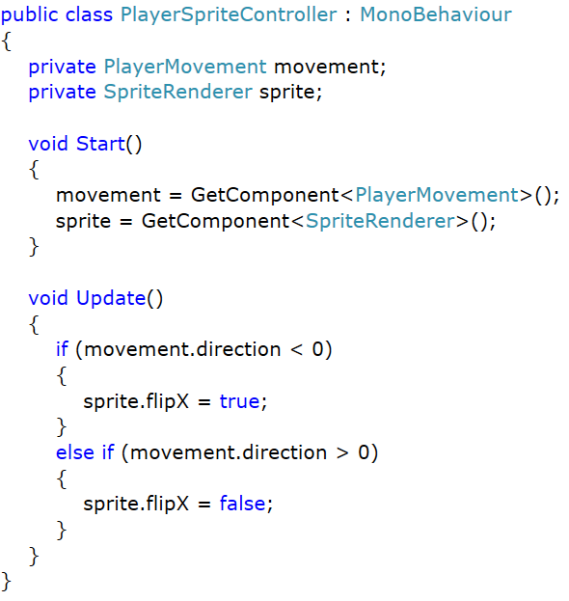
Player Sprite Controller
We want our sprite to face in the direction the player is moving
PlayerMovement has the direction stored as a variable
The Player object will have a sprite attached to it
Get both components in the Start method of the script
In the Update
If the direction is less than 0 (left) then flip the X axis of the sprite
Otherwise flip the sprite back to its default state

